Slide 1
SEMI-SUPERVISED LEARNING
Title: Introduction to semi-supervised Learning
Subtitle: A bridge Between Supervised And Unsupervised Learning
Presented by: Sonam
Date: 05-05-2025

Slide 2
Introduction to Machine Learning
Semi-Supervised Learning: Combines both labeled and unlabeled data.
Learning a small set of labelled data with large set of unlabelled data.

Slide 3
What is semi-Supervised learning
Definition: A learning paradigm that uses a small amount of labeled data and a large amount of unlabeled data to train models.
Key Points:
Reduces the need for extensive labeled datasets.
Improves model accuracy by leveraging unlabeled data.
Visual: Show a diagram comparing labeled, unlabeled, and semi-supervised datasets.

Slide 4
How Does It Work?
Process Overview:
Train a model on the labeled data.
Use the model to predict labels for the unlabeled data.
Incorporate the newly labeled data into the training set.
Visual: Flowchart depicting this iterative process.

Slide 5
Common Algorithms
List of Algorithms:
Self-Training
Label Propagation
Graph-Based Methods
Semi-Supervised Support Vector Machines (S3VM)
Visual: Icons or small diagrams representing each algorithm.

Slide 6
Real-World Applications
Images recognition
Text classification
Speech recognition
Web content classification

Slide 7

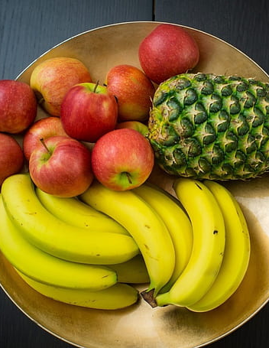
Add real –life analogies
Analogy: Imagine teaching a child to identify fruits. You show them 2 apples and 2 bananas, then ask them to guess other fruits in a basket.

Slide 8

Advantages & Limitations
Advantages:
Reduces labeling costs.
Utilizes large amounts of unlabeled data.
Improves model performance.
Limitations:
Quality of unlabeled data affects performance.
Requires careful algorithm selection.

Slide 9

Thank you

